Slide 1
Visual Pathway
Dr Reshmy K.R
Professor
Dept.of Physiology
SKHMC

Slide 2
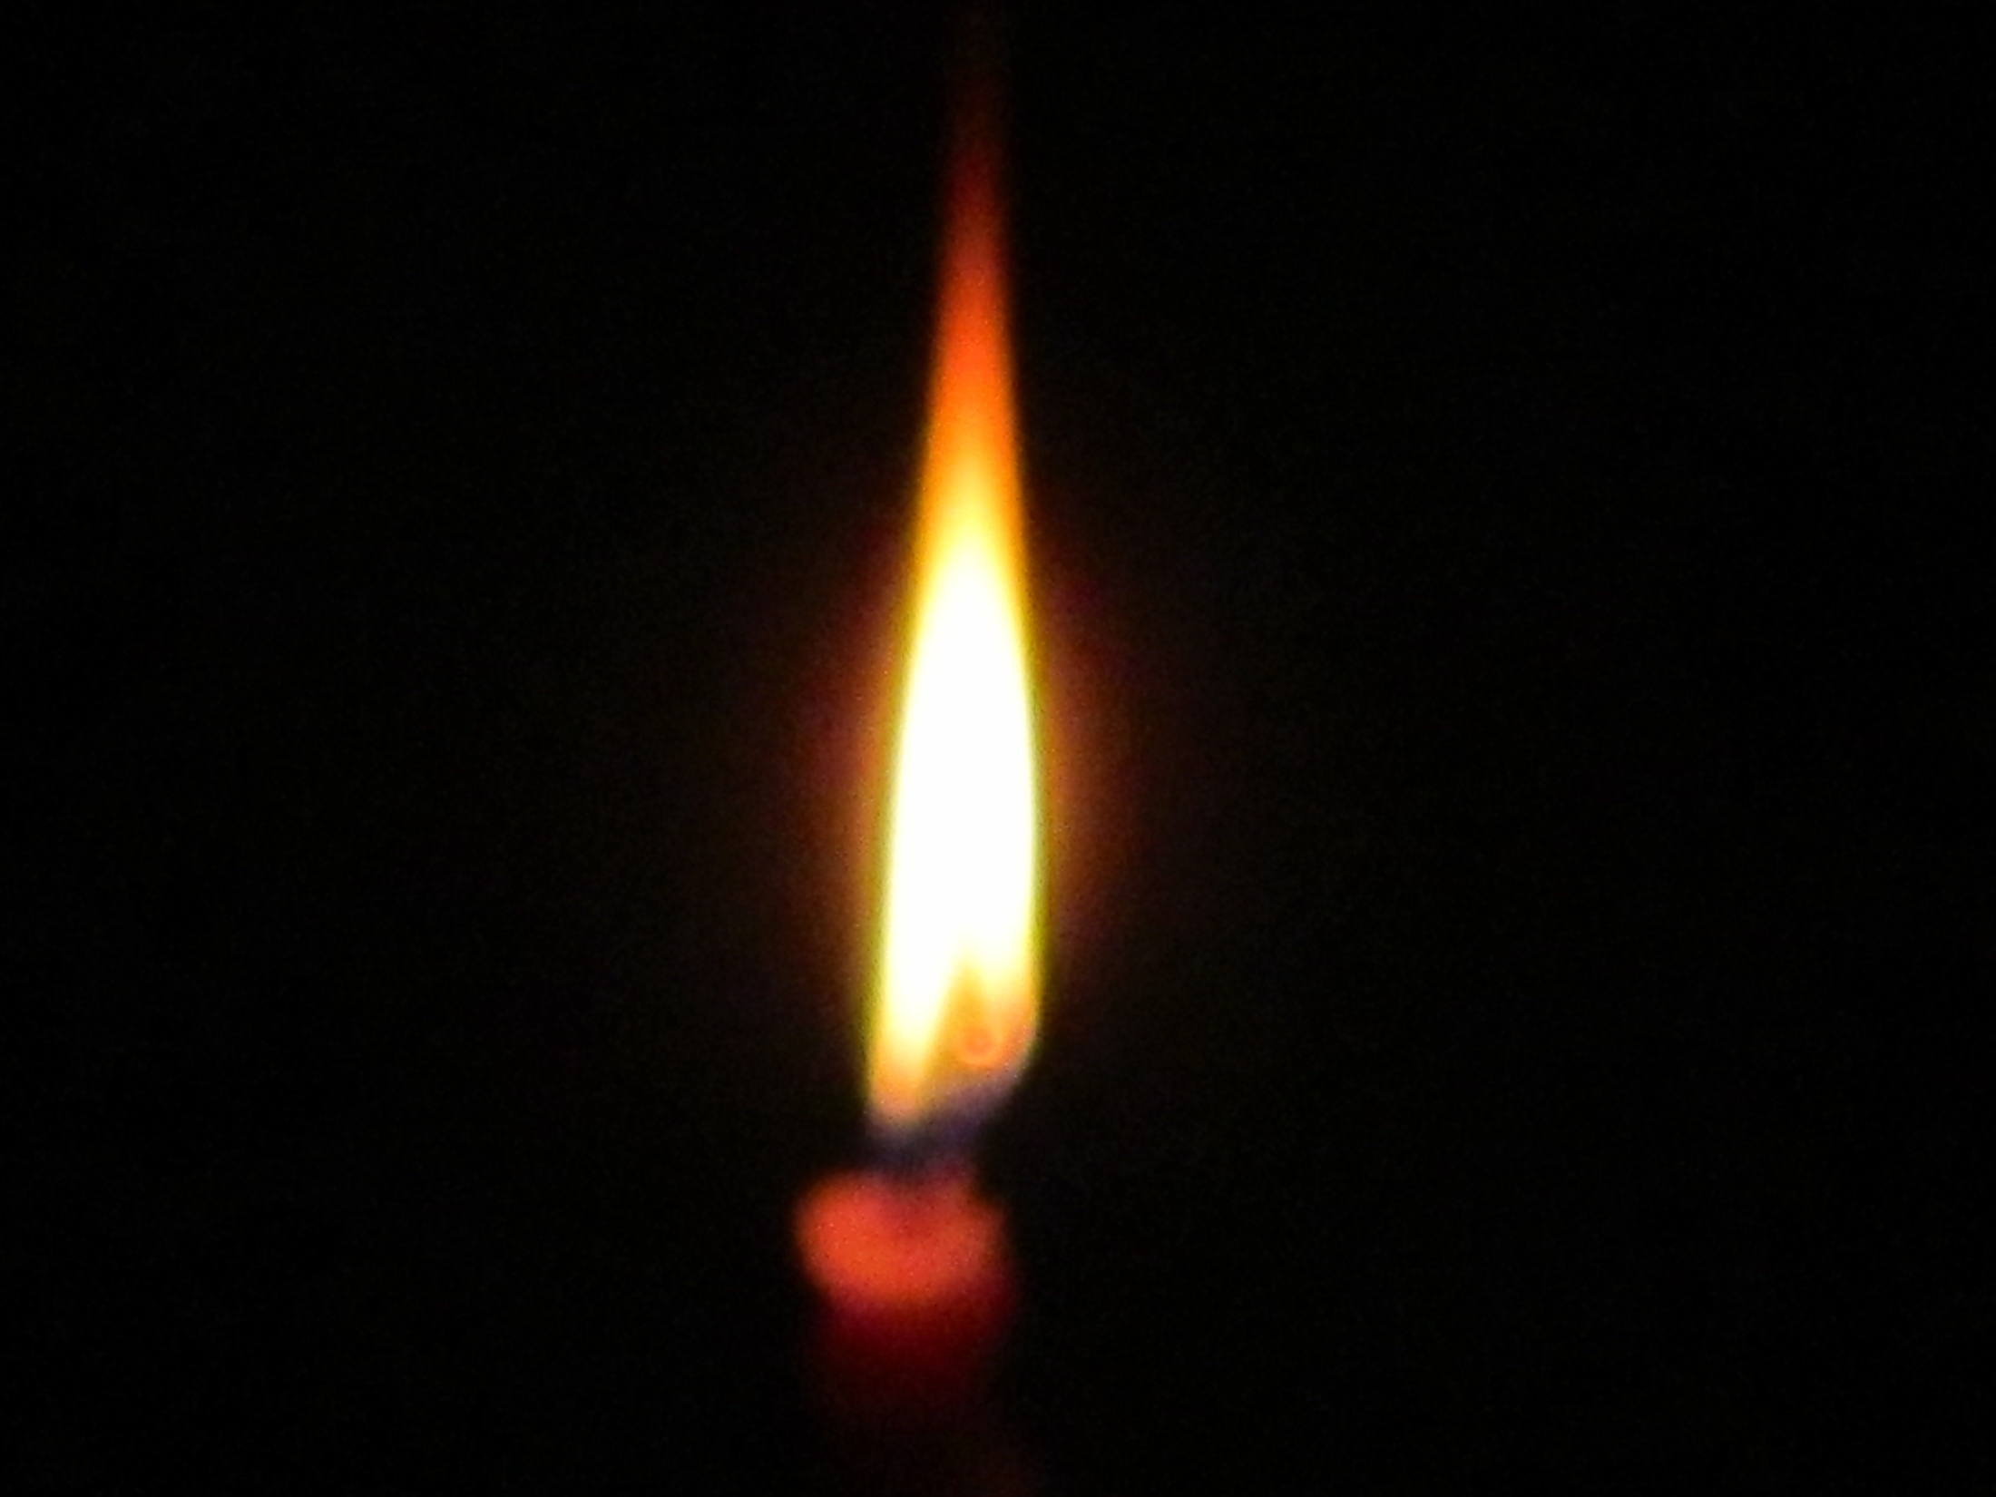
Thank you

Slide 3
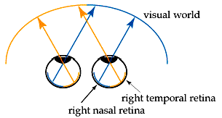

Slide 4
Visual field
The part of external world seen by one eye when it is fixed in one direction is called visual field of that eye.

Slide 5
We have essentially two halves of the retina, a left half and a right half.
The halves are referred to as a temporal half (next to your temple) and a nasal half (next to your nose).

Slide 6
Visual images are inverted as they pass through the lens.
Therefore, in the right eye, the nasal retina sees the right half of the world, while the temporal retina sees the left half of the world.

Slide 7
Temporal field and nasal field by a vertical line passing through the fixation point.
outer field -temporal
inner field field nasal
the temporal part of visual field extends up to about 100 degree but the nasal part extends only up to 60 degree de to the restriction by nose

Slide 8
Upper and lower field by a horizontal line passing through the fixation point.
The extent of upper field is-60 degree as it is restricted by upper eyefield and orbital margin
The extent of lower field is 75 degree -as it is restricted by the cheek.

Slide 9
The right nasal retina and the left temporal retina see pretty much the same thing.
If a line is drawn through the world at our nose, we can see everything to the right of that line. That field of view is called the right hemifield

Slide 10
In binocular vision , the light rays from temporal (outer) half of visual field fall upon the nasal part of corresponding retina.
The rays from nasal (inner) half of visual field fall upon the temporal part of retina

Slide 11
So, what we see is divided into right and left hemifields.
Each eye gets information from both hemifields.
For every object that we can see, both eyes are actually seeing it - this is crucial for depth perception -
but the image will be falling on one nasal retina and one temporal retina.

Slide 12
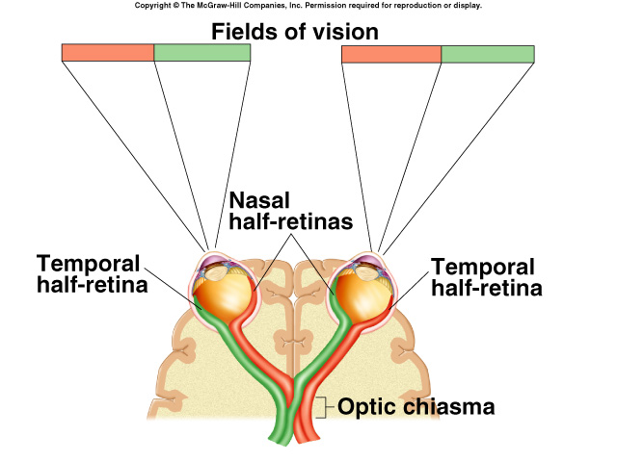
Visual Field
Image projected onto retina is reversed in each eye.
Cornea and lens focus the right part of the visual field on left half of retina.
Left half of visual field focus on right half of each retina.

Slide 13
Visual pathway

Slide 15
Optic chiasma

Slide 16
Optic chiasma
Specifically, fibers from the nasal retinas cross over at the optic chiasm -
whereas the temporal retinas, already positioned to see the opposite side of the world, do not cross.

Slide 17
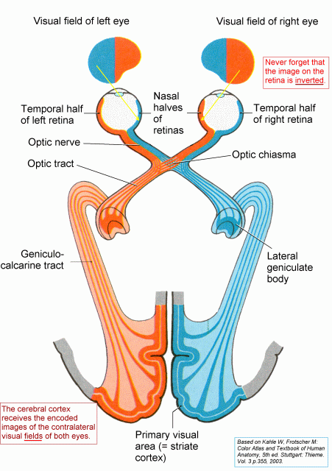

Slide 18
Optic tract
Vision is generated by photoreceptors in the retina, a layer of cells at the back of the eye.
The information leaves the eye by way of the optic nerve, and there is a partial crossing of axons at the optic chiasm.
After the chiasm, the axons are called the optic tract.

Slide 19
Optic tract

Slide 20
Left optic tract
Left optic tract carries impulses from temporal part of left retina and nasal part of right retina.
-vision in nasal half of left visual field and temporal half of right visual field

Slide 21
Right optic tract
Right optic tract contains fibers from nasal half of left retina and temporal half of right retina
Responsible for vision in temporal half of left visual field and nasal half of right visual field

Slide 22
Image formation
Recall that the brain works on a crossed wires system.
The left half of the brain controls the right side of the body, and vice versa.
Therefore the left half of the brain is only interested in visual input from the right side of the world.

Slide 23
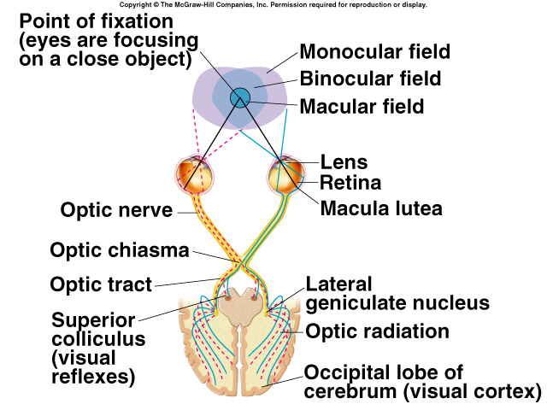
Neural Pathways from Retina
Right half of visual field projects to left half of retina of both eyes.
Left half of visual field projects to right half of retina of both eyes.
Left lateral geniculate body receives input from both eyes from the right half of the visual field.
Right lateral geniculate body receives input from both eyes from left half of visual field.

Slide 24
Information about the world enters both eyes with a great deal of overlap.
Try closing one eye, and you will find that your range of vision in the remaining eye is mainly limited by your nose.
The image projected onto your retina can be cut down the middle, with the fovea defining the center.

Slide 25
Optic radiations
The optic tract wraps around the midbrain to get to the lateral geniculate nucleus (LGN), where all the axons must synapse.
From there, the LGN axons fan out through the deep white matter of the brain as the optic radiations, which will ultimately travel to primary visual cortex, at the back of the brain.

Slide 26
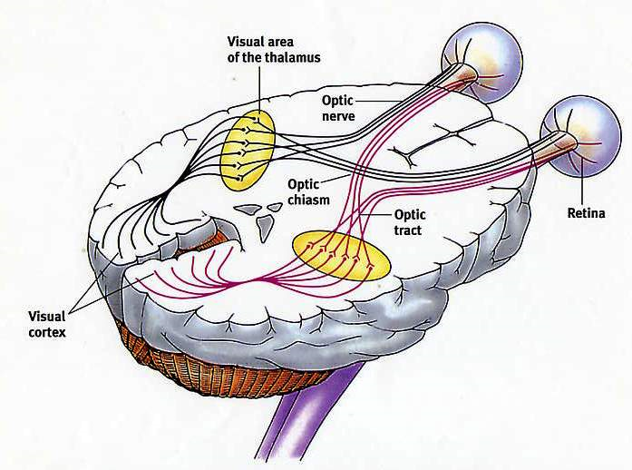
visual cortex

Slide 27
Lesions of Visual pathway
The practical consequences of this crossing are that damaging the visual system before the chiasm will affect one eye, both hemifields - analogous to closing one eye.
Damaging the pathway after the chiasm, though, will damage parts of both eyes, and only one hemifield.

Slide 28
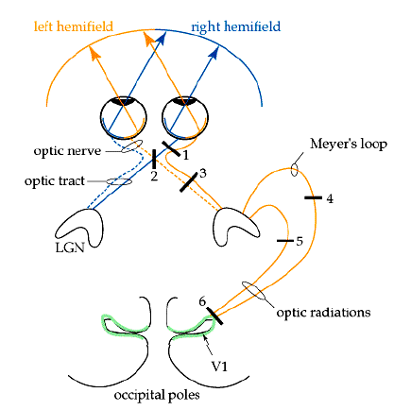

Slide 31
Effect of lesions
Damage at site 1: this would be like losing sight in the left eye.
The entire left optic nerve would be cut and there would be a total loss of vision from the left eye.
Damage at site 2: partial damage to the left optic nerve.
Here, information from the nasal visual field of the left eye (temporal part of the left retina) is lost.

Slide 32
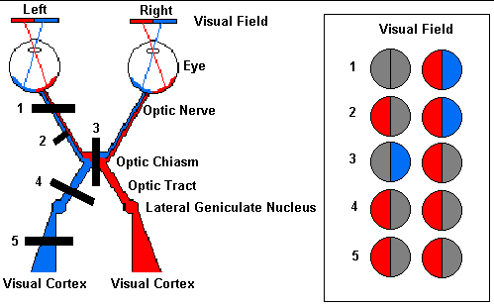

Slide 33
Effect of lesions
Damage at site 3: the optic chiasm would be damaged.
In this case, the temporal (lateral) portions of the visual field would be lost. The crossing fibers are cut
Damage at site 4 and 5: damage to the optic tract 4) or the fiber tract from the lateral geniculate to the cortex (5) can cause identical visual loss. In this case, loss of vision of the right side.
Partial damage to these fiber tracts can cause other predictable visual problems.

Slide 35
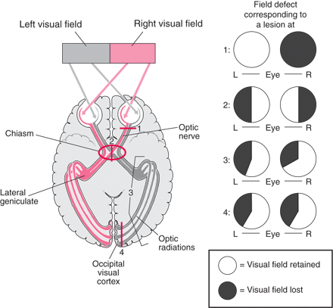

Slide 36
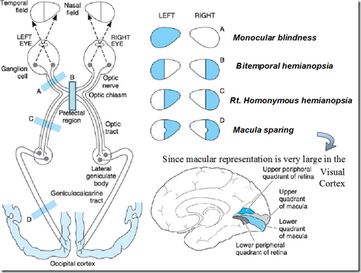

Slide 37
Macular sparing

Slide 38
Perimetry

Slide 39
THANK YOU
Thank you
http://kellogg.umich.edu/theeyeshaveit/anatomy/visual_pathway_lesions.html
https://en.wikipedia.org/wiki/Visual_system

